Slide 1
Distributed Data Management Spark Homework
Ivan Avdieienko, Anastasiia Zhuravlova, Illia Rozhkov

Slide 2
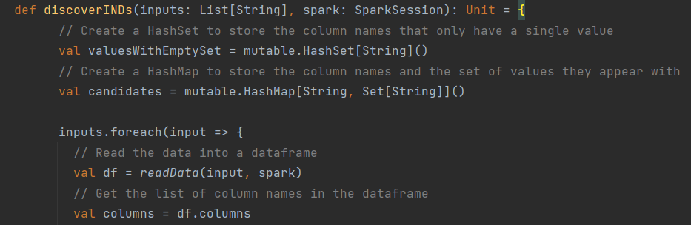
Start with defining Spark dataframes and beginning of files checking

Slide 3
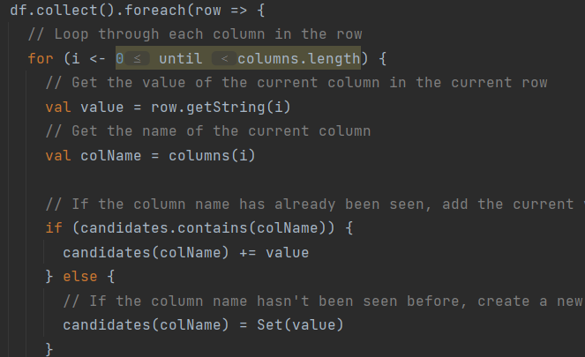
Loop that check every row and column for the IND candidates

Slide 4
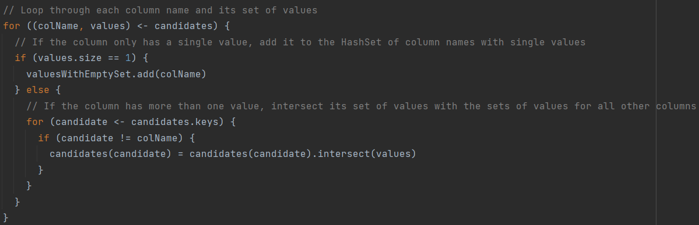
Intersect the set of values for each column with the sets of values for all other columns.

Slide 5
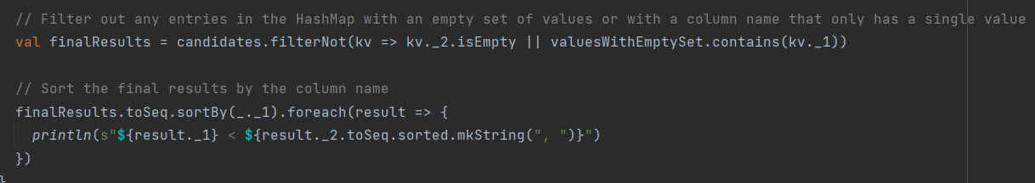
Filters out entries with an empty set of values or with a column name that only has a single value. Sorts the final results by the column name and prints dependencies

